Slide 1

Gamma Demo Scorecard for Cash Loan
Presented by:
Data Science
16th June 2025

Slide 2
Architecture Overview of TDB’s Risk Scorecards
For Cash Loan only
For both Cash and SIL
Limit Setting Model (Hosted in Digital Layer)
Credit Decisioning Model (Hosted in Taran)
Beta Stack
Alpha Stack
Trench 1: New Users - within 30 days from TSA Onboarding AND Never Disbursed Loan
Limit Setting Score = Gamma Stack
Beta Demo Score
Beta Demo Score
Gamma Demo Score
Apps Score
Apps Score
Selectively call Alpha
Apps Score
Credo Score
Users automatically move from Trench 1 to Trench 2 after 30 days if no disbursed loans
Credo Score
CIC Score
Gamma Income Model
Beta Income Model
Alpha Income Model
Users will stay in Trench 2 until 1st disbursed loan. His Gamma Stack will be re-calculated every 30-day anniversary from TSA onboarding date
Limit Setting Score = Gamma Stack
Beta Stack
Alpha Stack
Gamma Demo Score
Beta Demo Score
Beta Demo Score
Trench 2: Existing Users - After 30 days from TSA Onboarding AND Never Disbursed Loan
Apps Score
Apps Score
Selectively call Alpha
Apps Score
Transaction Score
Transaction Score
Transaction Score
CIC Score
Gamma Income Model
Beta Income Model
Alpha Income Model
Users will move to Trench 3 after 1st Disbursed Loan
Lowest Risk users from this B Score will be pre-approved for upsell and xsell. Medium Risk users from this B Score will have to go through Taran.
High Risk users from this B Score will not be given any offer.
B Score = Gamma Stack
Trench 3: Existing Users - After 30 days from 1st Disbursed Loan AND current DPD <= 10
Gamma Demo Score
Beta Stack
Alpha Stack
Apps Score
Beta Demo Score
Beta Demo Score
Apps Score
Apps Score
Enhanced Transaction Score
Selectively call Alpha
Enhanced Transaction Score
Once moved to Trench 3, user will forever remain in Trench 3. His Gamma Stack will be re-calculated every 30 days anniversary from 1st Loan Disbursement Date
Enhanced Transaction Score
CIC Score
Gamma Income Model
Beta Income Model
Alpha Income Model

Slide 3
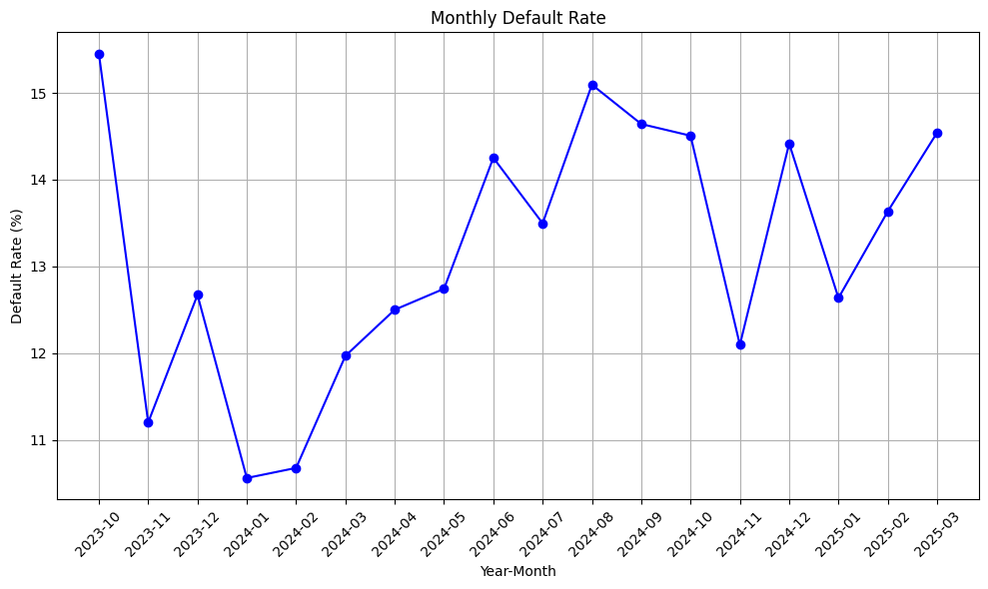
Cash Gamma Demo Score was developed on Trench 1 (DOB <= 30 and without any disbursed loan) and Trench 2 (DOB > 30 and without any disbursed loan)
 | Loan Disbursement Date | # CASH Loans |  |  | # Bad (FPD30) CASH Loans |  |  | FPD30 rate
 |  | Overall | Trench1 | Trench2 | Overall | Trench1 | Trench2 | Overall | Trench1 | Trench2
All Data Training – 90%,val – 10% | 06/10/2023 - 31/12/2024 | 21152 | 13348 | 7804 | 2916.0 | 1838.0 | 1078.0 | 0.1378 | 0.1376 | 0.1381
Jan | 01/01/2025 - 31/01/2025 | 2485 | 1596 | 889 | 314.0 | 198.0 | 116.0 | 0.1263 | 0.1240 | 0.1304
Feb | 01/02/2025 - 28/02/2025 | 2479 | 1442 | 1037 | 338.0 | 177.0 | 161.0 | 0.1363 | 0.1227 | 0.1552
Mar | 01/03/2025 – 31/03/2025 | 2001 | 952 | 1049 | 291.0 | 126.0 | 165.0 | 0.1454 | 0.1323 | 0.1572

Slide 4
Model Iteration ​ | Top Features​ | Train Gini​ (2023-10-06- 2024-12-31)​ | Val Gini​ | Jan Gini | Feb Gini | Mar Gini
8 | ln_self_dec_income, ln_nature_of_work_new_cat, ln_industry_new_cat_bin, ln_age, days_since_os_version_release, ln_marital_status, ln_education_level, ln_employment_type_new_cat, | 0.3542 | 0.2934 | 0.1703 | 0.2669 | 0.2708
9 | days_on_book, | 0.3704 | 0.2943 | 0.1665 | 0.2575 | 0.2582
10 | ln_source_funds_new_cat, | 0.3617 | 0.3006 | 0.1728 | 0.262 | 0.2634
11 | ln_doc_type_rolled, | 0.3731 | 0.2974 | 0.1878 | 0.2755 | 0.2631
12 | email_primary_domain, | 0.372 | 0.3031 | 0.1945 | 0.2766 | 0.2663
13 | name_email_match_score, | 0.3822 | 0.3052 | 0.1999 | 0.2707 | 0.2646
14 | Onboarding_time_of_day_cat, | 0.383 | 0.3029 | 0.2023 | 0.2802 | 0.2643
15 | ln_brand_cat, | 0.3867 | 0.3059 | 0.1994 | 0.2713 | 0.278
16 | ln_cnt_dependents, | 0.3894 | 0.3026 | 0.2027 | 0.278 | 0.281
17 | ln_province_cat | 0.3865 | 0.3069 | 0.2 | 0.2755 | 0.2786
16 feature model after Hyper Parameters Tuning​ | ​ | 0.4139 | 0.3034 | 0.1985 | 0.2912 | 0.2775

Slide 5
Cash Gamma Demo Model Performance
Gamma Demo Model Gini | 06/10/2023 - 31/12/2024 |  | 01/01/2025 - 31/01/2025 ​ | 01/02/2025 - 28/02/2025 ​ ​​ | 01/03/2025 -31/03/2025​​
​ | Train Gini (90%)​​ | Val Gini (10%)​​ | Jan Gini​​ | Feb Gini​​ | Mar Gini
Overall Demo Model Gini | 0.4139 | 0.3034 | 0.1985 | 0.2912 | 0.2775
Demo Trench 1 Gini |  |  | 0.1994 | 0.2666 | 0.2452
Demo Tench 2 Gini |  |  | 0.2221 | 0.2905 | 0.3182

Slide 6
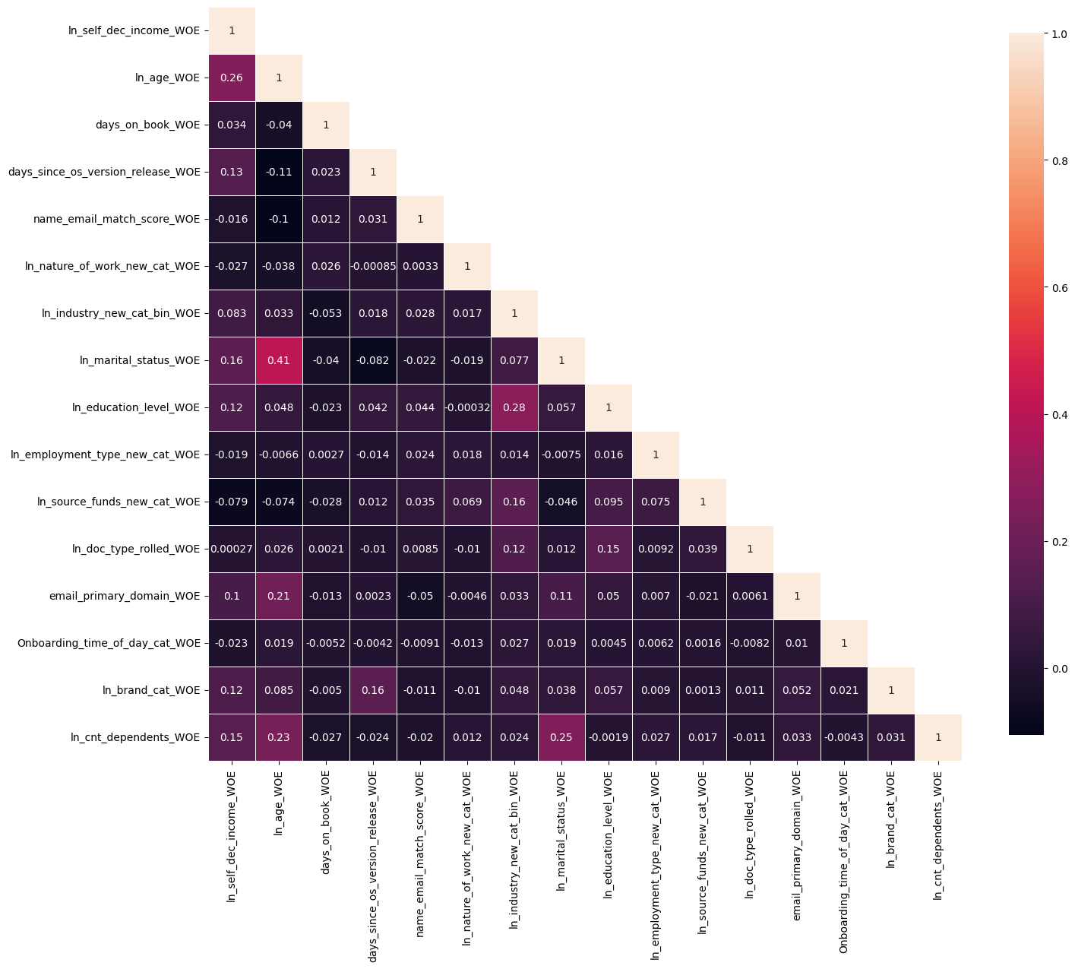
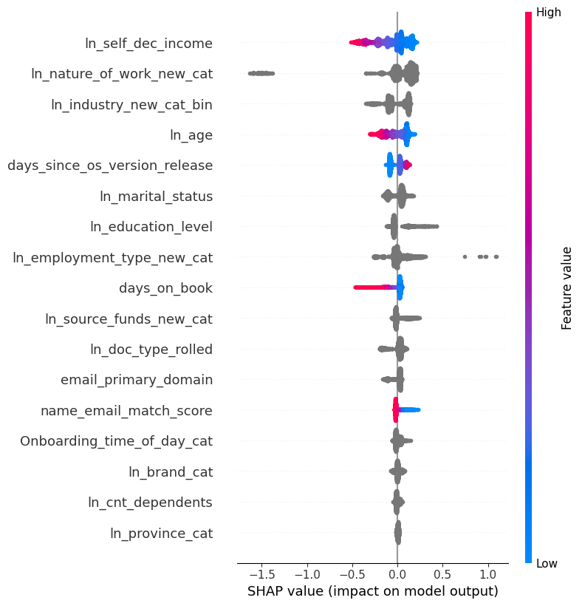
Gamma Quick Demo – Model Performance

Slide 7
Gamma Demo Quick

Slide 8
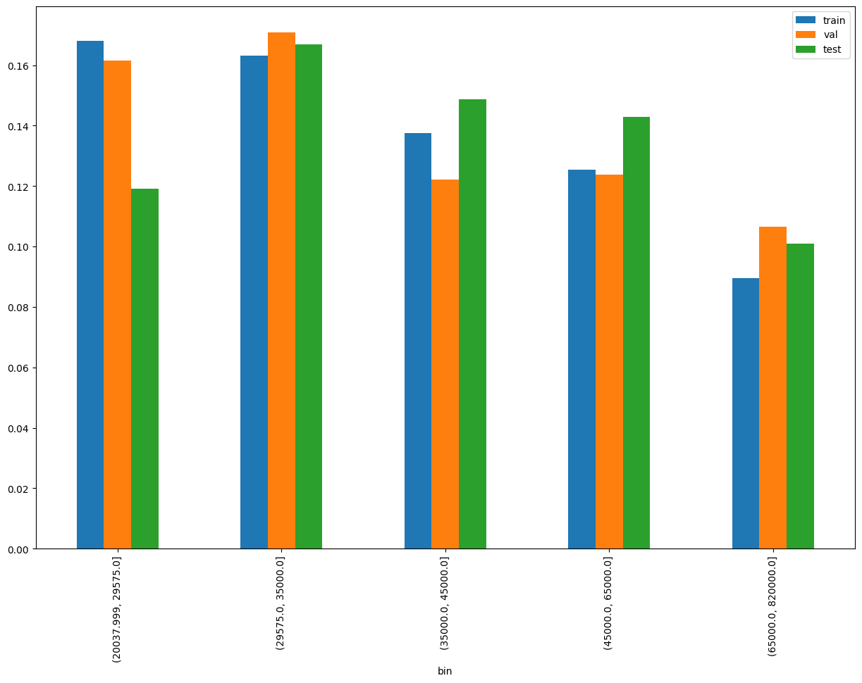
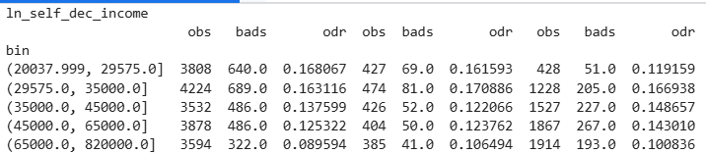
SHAP Rank: 1
ln_self_dec_income = Self declared Monthly income

Slide 9
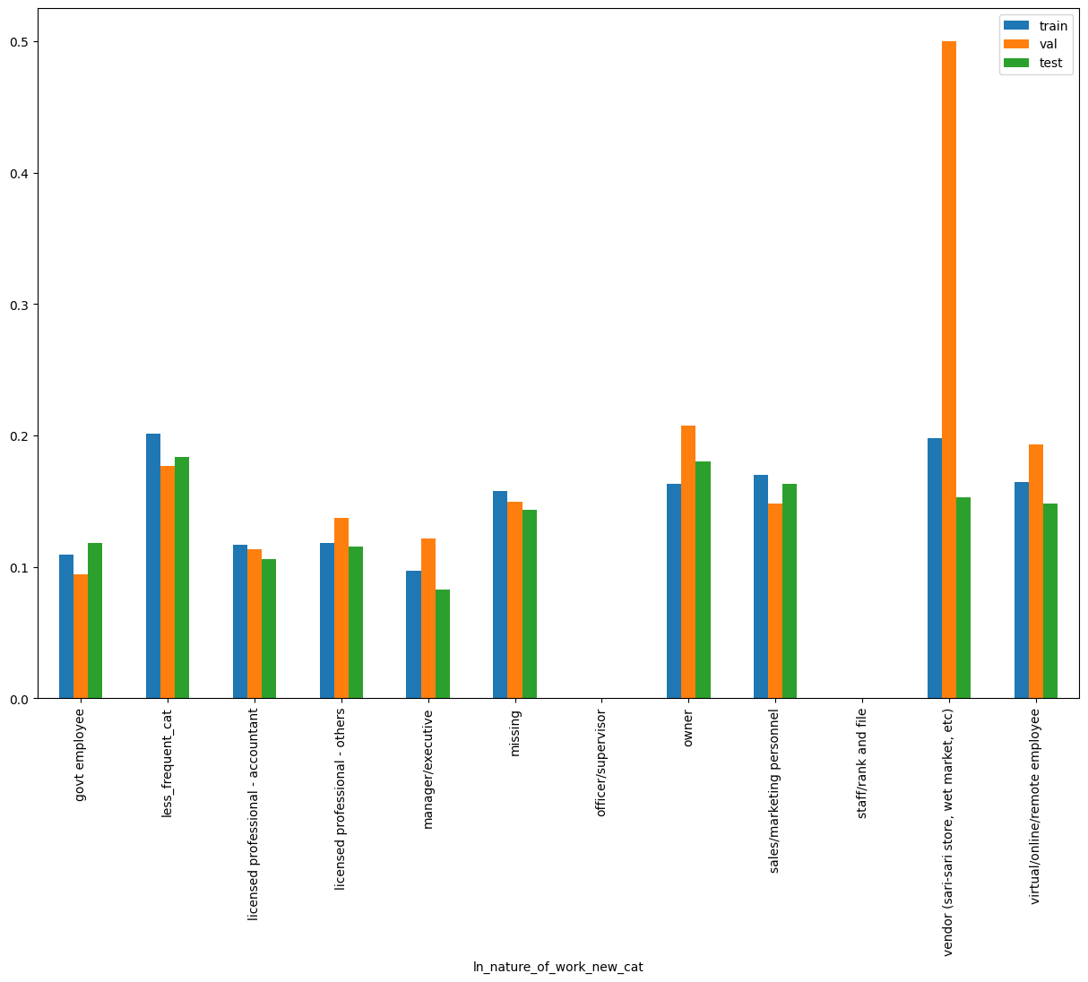
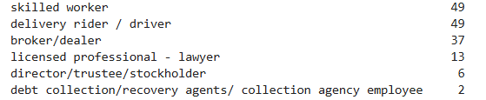
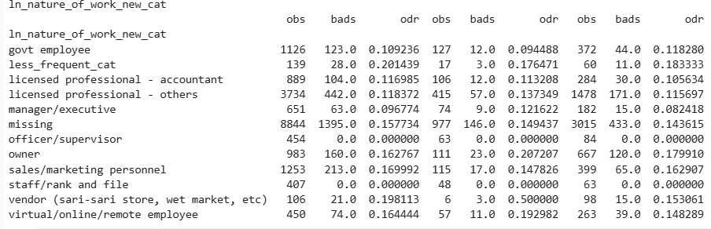
SHAP Rank: 2
ln_nature_of_work_new_cat = nature of work of the customer ( Used Regex to rollup the feature)
distribution of less_frequent_cat
Notes:
nature_of_work_reference_map = {
r'(?i)^licensed\s*professional(?:\s*[-/])?\s*others$': 'licensed professional - others',
r'(?i)\bgov(?:ern(?:ment)?|t|n)\b': 'govt employee',
r'(?i)^(?:sales(?:\s*/\s*|\s+)marketing\s+personnel|marketing\s+personnel)$': 'sales/marketing personnel',
r'(?i)^licensed\s*professional(?:\s*[-/])?\s*accountant$': 'licensed professional - accountant',
r'(?i)^owner$': 'owner',
r'(?i)^(manager\s*/?\s*executive|manager|executive)$': 'manager/executive',
r'(?i)\b(?:vendor(?:\s*\(.*?\))?|sari-sari\s*store|wet\s*market)\b' : 'vendor (sari-sari store, wet market, etc)',
r'(?i)\b(?:virtual|online|remote)(?:\s*/\s*(?:virtual|online|remote))*\s+employee\b' : 'virtual/online/remote employee',
r'(?i)\b(officer\s*/\s*supervisor|officer|supervisor)\b' : 'officer/supervisor',
r'(?i)\b(staff\s*/\s*rank\s+and\s+file|staff|rank\s+and\s+file)\b' : 'staff/rank and file'
# r'(?i)^(broker\s*/?\s*dealer|broker|dealer)$': 'broker/dealer',
# r'(?i)\b(debt\s*collection|recovery\s*agents|collection\s*agency\s*employee)\b': 'debt collection/recovery agents/ collection agency employee',
# r'(?i)\blicensed\s*professional(?:\s*[-/])?\s*lawyer\b|\blawyer\b': 'licensed professional - lawyer'
}
# Initialize a new column with default value
df['ln_nature_of_work_new_cat'] = 'new'
# Apply mapping using np.where
for pattern, label in nature_of_work_reference_map.items():
df['ln_nature_of_work_new_cat'] = np.where(df['ln_nature_of_work_new'].isna() | (df['ln_nature_of_work_new'] == ""), 'missing',
np.where(df['ln_nature_of_work_new'].isin(['delivery rider / driver','skilled worker','broker/dealer',
'licensed professional - lawyer', 'director/trustee/stockholder','debt collection/recovery agents/ collection agency employee', ]), 'less_frequent_cat',
np.where(df['ln_nature_of_work_new'].str.strip().str.lower().str.contains(pattern, regex=True),
label, df['ln_nature_of_work_new_cat']
)))

Slide 10
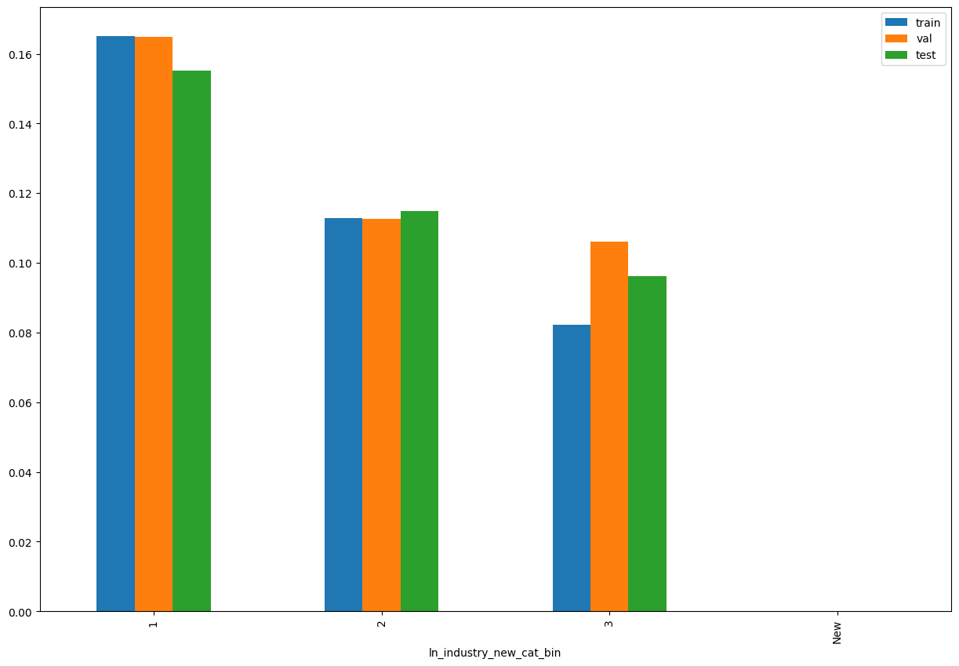
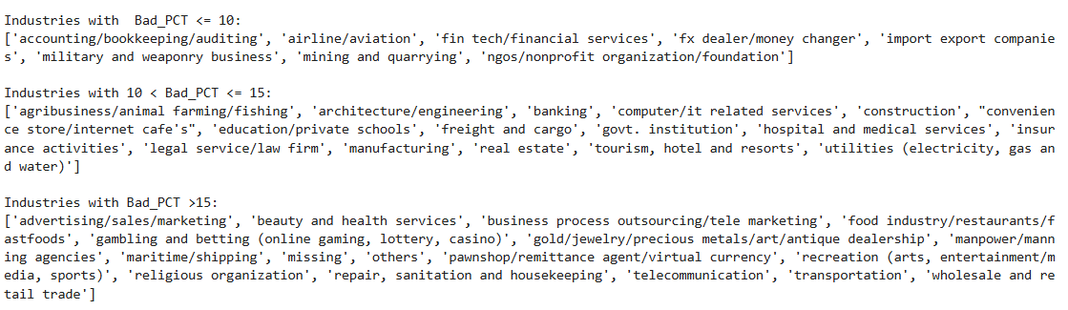
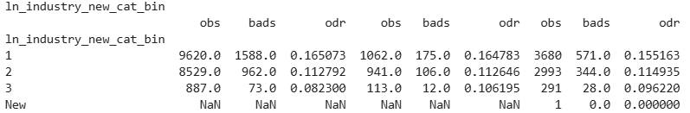
SHAP Rank: 3
ln_industry_new_cat_bin= Rolled up new Industry description
(Used Regex to identify the pattern)
Notes:
industry_desc_map = {
# r'(?i)^business\s*process\s*outsourcing(?:/tele\s*marketing)?$|^tele\s*marketing$': 'business process outsourcing/tele marketing',
r'(?i)(?:teleco|telco)': 'telecommunication',
r'(?i)^others$': 'others',
r'(?i)^(?:accounting|bookkeeping|auditing)(?:/bookkeeping)?(?:/auditing)?$': 'accounting/bookkeeping/auditing',
r'(?i)^computer(?:/it\s*related\s*services)?$|^it\s*related\s*services$': 'computer/it related services',
r'(?i)^(?:govt\.?|government\.?)\s*institution$': 'govt. institution',
r'(?i)^education(\s*/\s*private\s*schools|[\s]+private\s*schools)?$|^private\s*schools$': 'education/private schools',
r'(?i)^(?:wholesale\s+and\s+)?retail\s+trade$': 'wholesale and retail trade',
r'(?i)\b(beauty|health(?:\s+and\s+beauty)?(?:\s+services)?)\b': 'beauty and health services',
r'(?i)^freight(?:\s+and\s+cargo)?$|^cargo$': 'freight and cargo',
r'(?i)^transportation$': 'transportation',
r'(?i)bank': 'banking',
r'(?i)insurance': 'insurance activities',
r'(?i)\b(recreation|arts|entertainment|media|sports)\b': 'recreation (arts, entertainment/media, sports)',
r'(?i)\b(?:architecture\s*/\s*engineering|architecture|engineering)\b': 'architecture/engineering',
r'(?i)^(?=.*\b(advertising|sales|marketing)\b)(?!.*tele\s*marketing).*':
'advertising/sales/marketing',
r'(?i)^construction$': 'construction',
r'(?i)\b(?:food\s*industry\s*/\s*restaurants\s*/\s*fastfoods|food\s*industry|restaurants|fastfoods)\b':
'food industry/restaurants/fastfoods',
r'(?i)manufacturing': 'manufacturing',
r'(?i)\b(?:hospital\s+and\s+medical\s+services|hospital|medical\s+services)\b': 'hospital and medical services',
r'(?i)^real estate$': 'real estate',
r'(?i)\b(?:tourism,\s*hotel\s+and\s+resorts|tourism|hotel\s+and\s+resorts|hotel|resorts)\b':
'tourism, hotel and resorts',
r'(?i)\b(?:fin\s*tech\s*/\s*financial\s*services|fin\s*tech|financial\s*services)\b':
'fin tech/financial services',
r'(?i)\b(?:maritime\s*/\s*shipping|maritime|shipping)\b': 'maritime/shipping',
r'(?i)\b(?:manpower/manning\s*agencies|manpower|manning\s*agencies)\b': 'manpower/manning agencies',
r'(?i)\b(?:legal\s*service/law\s*firm|legal\s*service|law\s*firm)\b': 'legal service/law firm',
r'(?i)\b(?:pawnshop\s*/\s*remittance\s*agent\s*/\s*virtual\s*currency|pawnshop|remittance\s*agent|virtual\s*currency)\b':
'pawnshop/remittance agent/virtual currency',
r'(?i)\b(?:utilities\s*\(?(?:electricity|gas|water)[^\)]*\)?|utilities|electricity|gas|water)\b':
'utilities (electricity, gas and water)',
r'(?i)\b(?:ngos|non\s*profit\s*organization|foundation)\b': 'ngos/nonprofit organization/foundation',
r'(?i)\b(?:airline|aviation)\b': 'airline/aviation',
r'(?i)\b(?:agribusiness|animal\s*farming|fishing|agri)\b': 'agribusiness/animal farming/fishing',
r"(?i)(?:convenience\s*store|internet\s*cafe'?s?)": "convenience store/internet cafe's",
r'(?i)(?:gambling\s*and\s*betting|gambling|betting|online\s*gam|lottery|casino)':
'gambling and betting (online gaming, lottery, casino)',
r'(?i)\b(?:gold|jewelry|precious\s*metals|art|antique\s*dealership)\b':
'gold/jewelry/precious metals/art/antique dealership',
r'(?i)^religious organization$': 'religious organization',
r'(?i)\b(?:fx\s*dealer\s*/?\s*money\s*changer|fx\s*dealer|money\s*changer)\b': 'fx dealer/money changer',
r'(?i)\b(?:military and weaponry business|military|weaponry business)\b': 'military and weaponry business',
r'(?i)\b(business\s*process\s*outsourcing\s*/?\s*tele\s*marketing|business\s*process\s*outsourcing|tele\s*marketing|BPO)\b': 'business process outsourcing/tele marketing',
r'(?i)\b(housekeeping|sanitation|repair)\b' : 'repair, sanitation and housekeeping',
r'(?i)\b(import\s*export\s*companies|import\s*compan\w*|export\s*compan\w*)\b' : 'import export companies',
r'(?i)\b(mining\s+and\s+quarrying|mining|quarrying)\b' : 'mining and quarrying',
r'(?i)\b(designated\s+nonfinancial\s+businesses|nonfinancial\s+businesses)\b' : 'designated nonfinancial businesses',
# r'(?i)\b(housekeeping\s*/\s*sanitation\s*services|housekeeping|sanitation\s*services)\b' : 'housekeeping/sanitation services',
}
# Initialize a new column with default value
df['ln_industry_new_cat'] = 'new'
# Apply mapping using np.where
for pattern, label in industry_desc_map.items():
df['ln_industry_new_cat'] = np.where(df['ln_industry_new'].isna(), 'missing',
np.where( df['ln_industry_new'].str.strip().str.lower().str.contains(pattern, regex=True),
label, df['ln_industry_new_cat']
))

Slide 11
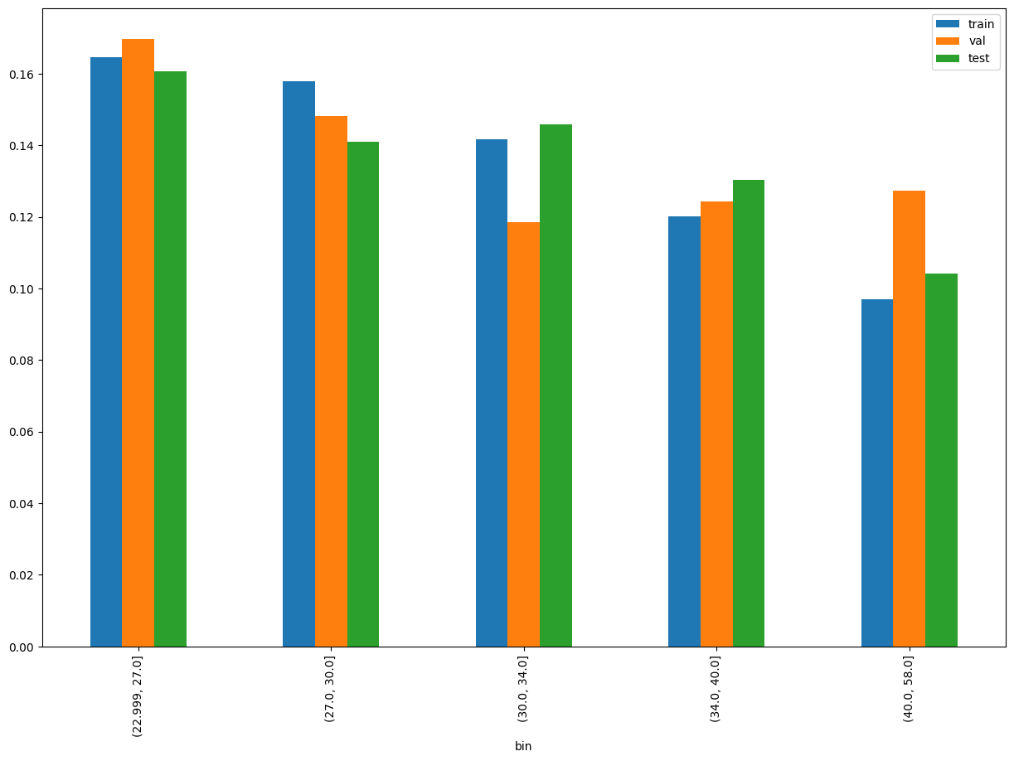
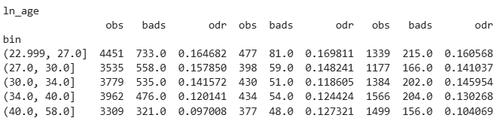
SHAP Rank: 4
ln_age= age of the customer

Slide 12
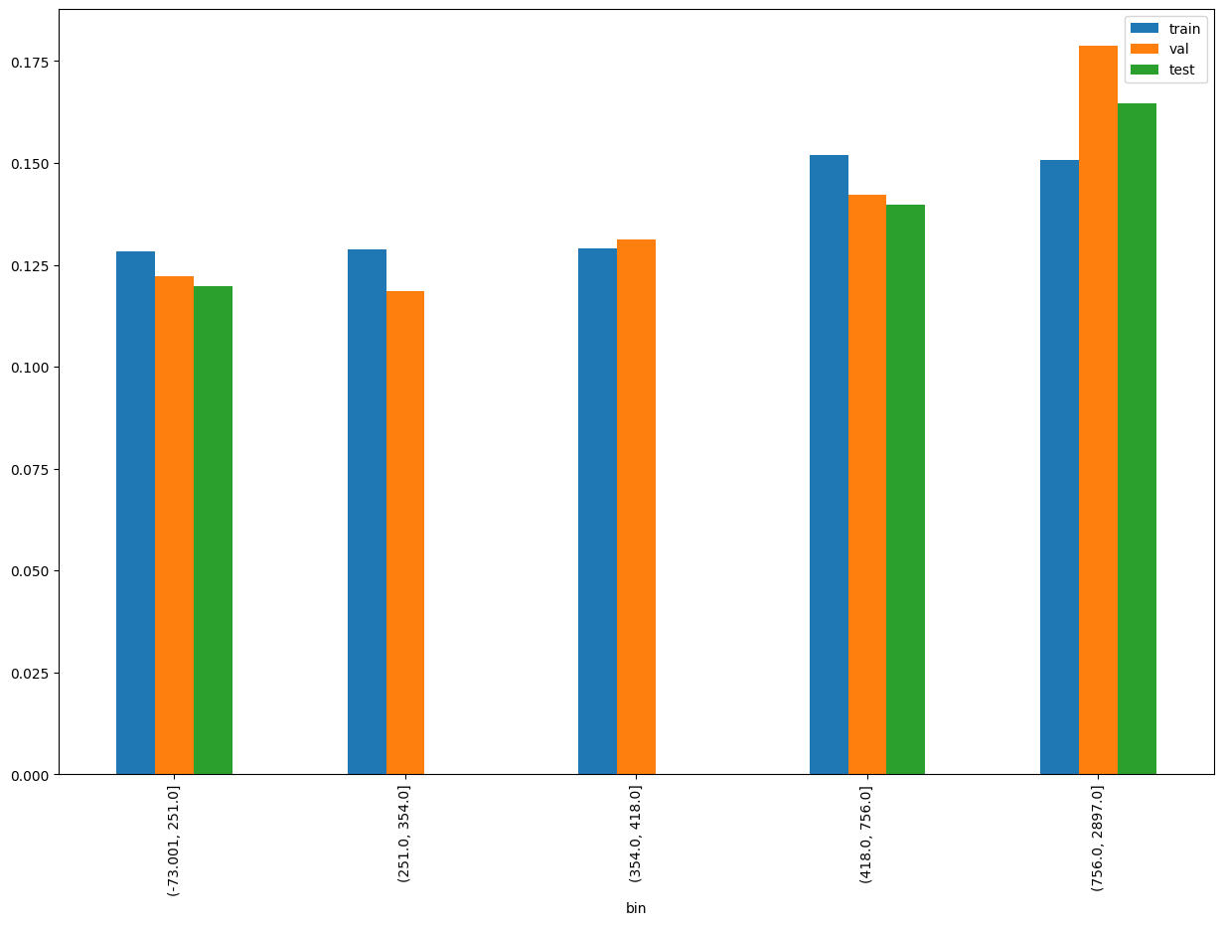
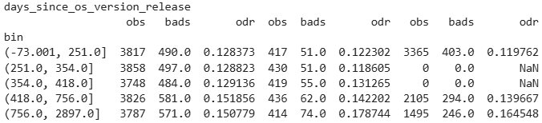
SHAP Rank: 5
days_since_os_version_release = ln_appli_subt_time – osversion_release_date)

Slide 13
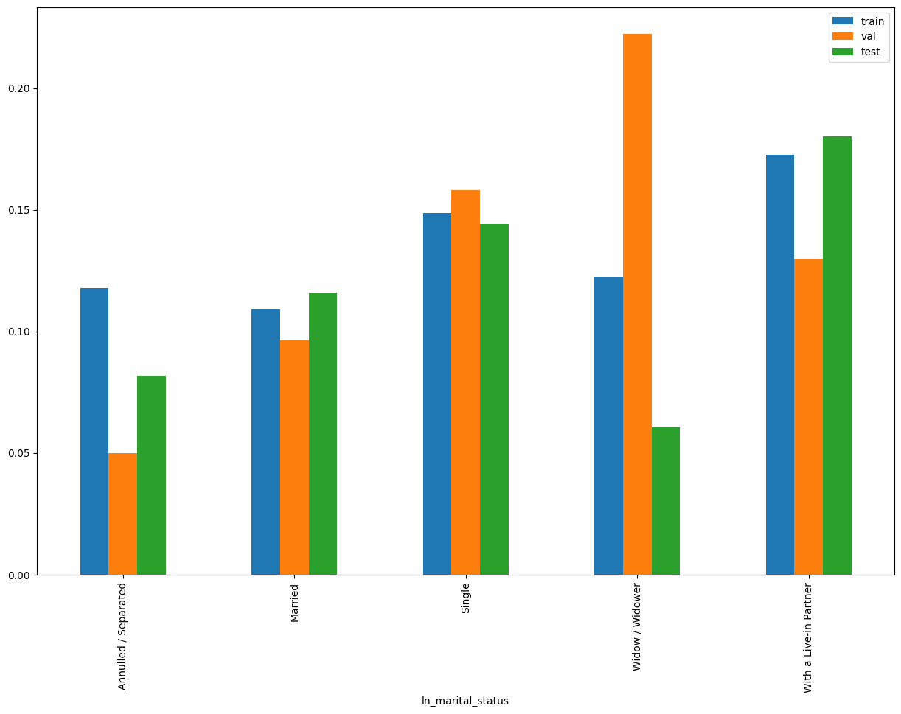
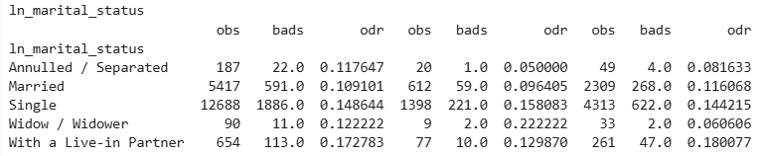
SHAP Rank: 6
ln_marital_status

Slide 14
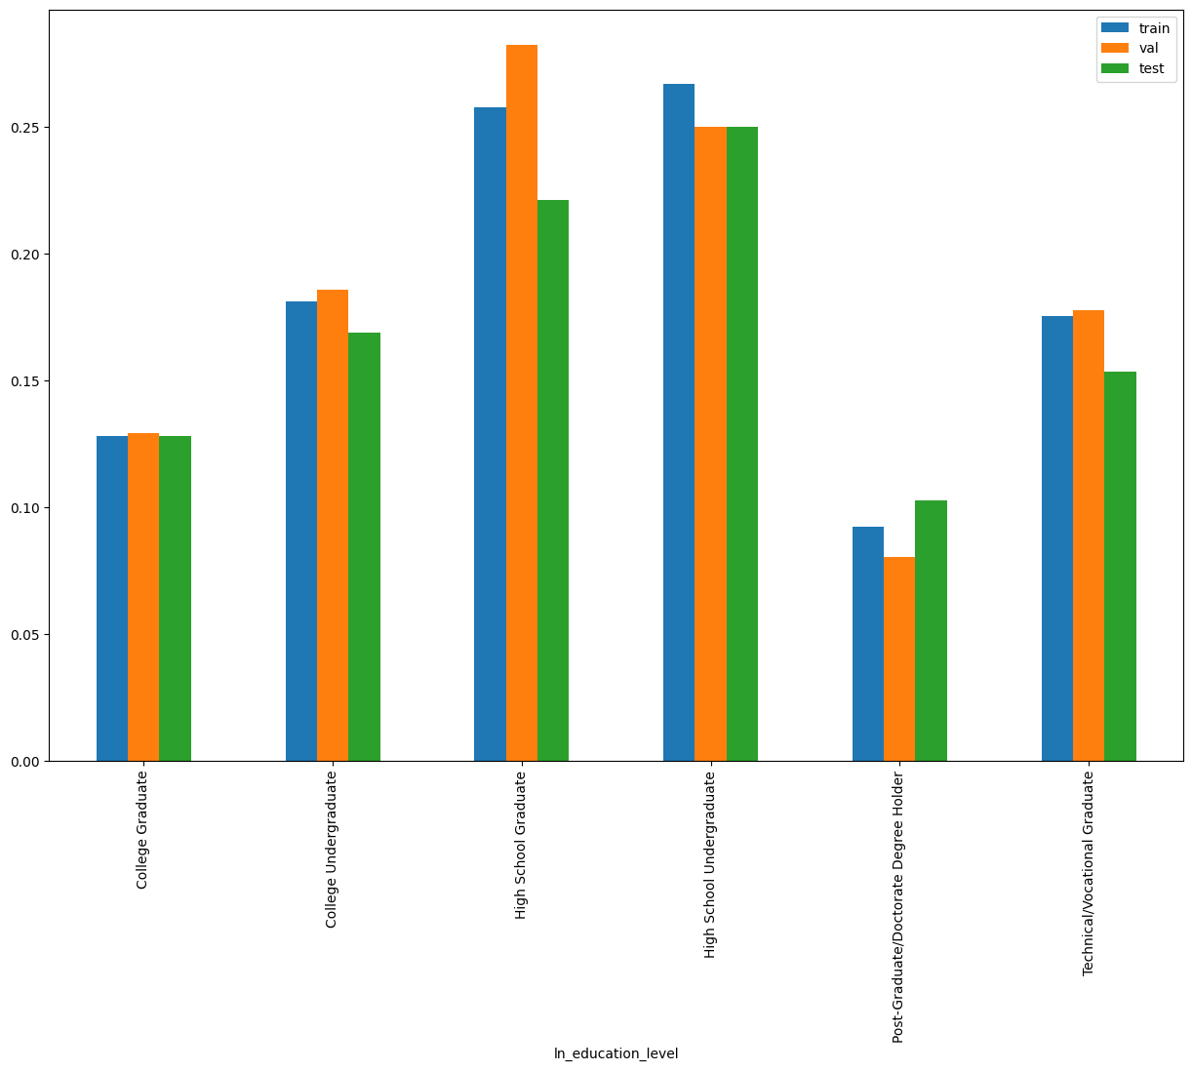
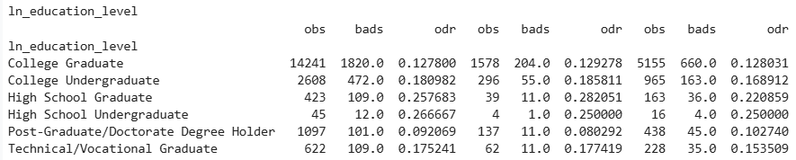
SHAP Rank: 7
ln_education_level

Slide 15
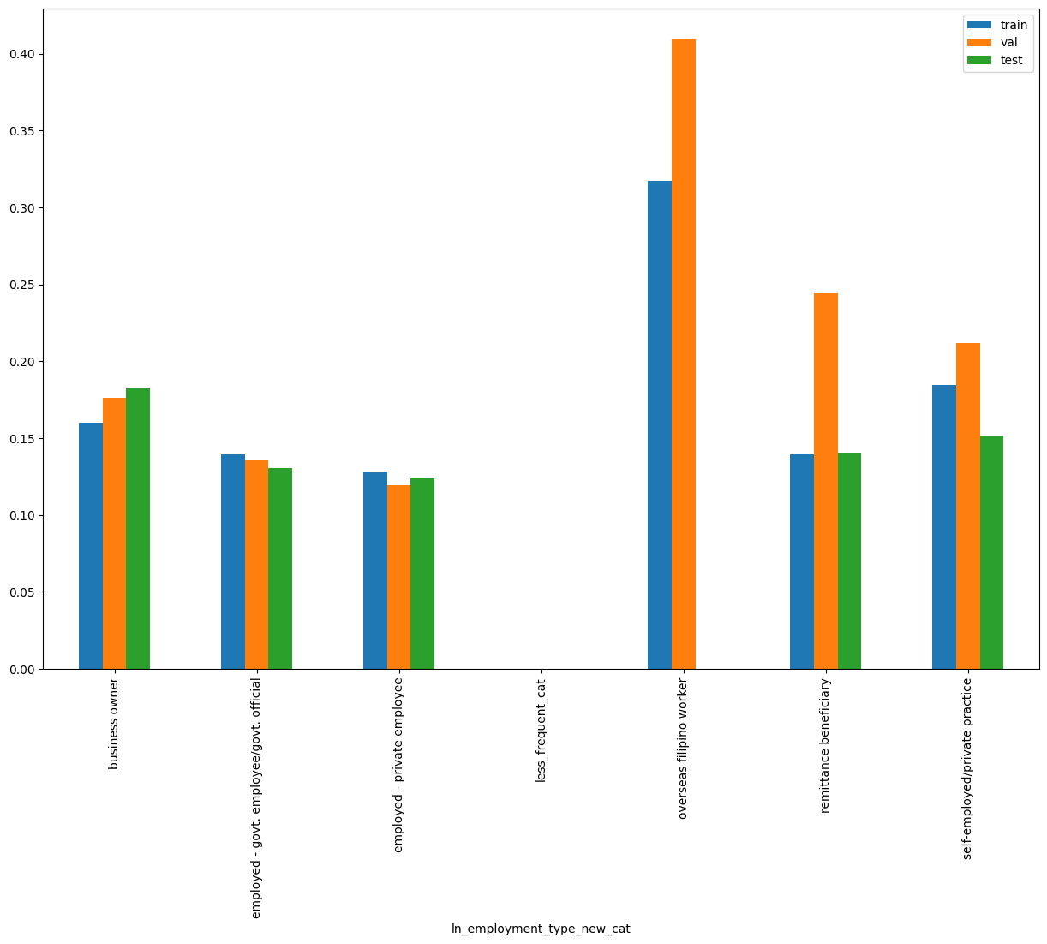

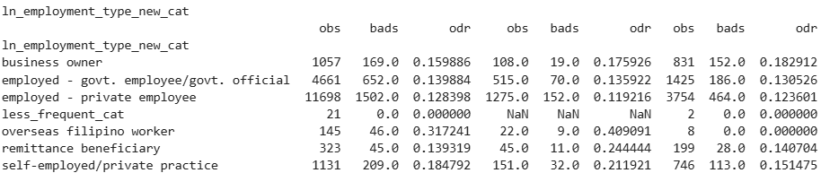
ln_employment_type_new_cat – Employment type
Of the customer ( Used Regex to identify the pattern and rollup the feature)
SHAP Rank: 8
distribution of less_frequent_cat
Notes:
employment_reference_map = {
r'(?i)^employed\s*-\s*(govt\.?|government)(?:\s*employee)?(?:\/(?:govt\.?|government)?\s*official)?$|^(?:govt\.?|government)\s*(?:employee|official)$':'employed - govt. employee/govt. official',
r'(?i)\b(filipin[o|a])\s+worker\b|OFW': 'overseas filipino worker',
r'(?i)^employed\s*-\s*private\s*(?:employee|employed)$|^private\s*(?:employee|employed)$':'employed - private employee',
r'(?i)^self[-\s]*employed(?:\/private\s*practice)?$|^private\s*practice$':'self-employed/private practice',
r'(?i)^remittance\s*beneficiary$': 'remittance beneficiary',
r'(?i)^business\s*[-]?\s*owner$': 'business owner',
# r'(?i)\bhouse\s*-?\s*(wife|husband)\b': 'housewife/househusband'
}
# Initialize a new column with default value
df['ln_employment_type_new_cat'] = 'new'
# Apply mapping using np.where
for pattern, label in employment_reference_map.items():
df['ln_employment_type_new_cat'] = np.where(df['ln_employment_type_new'].isna(), 'missing',
np.where(df['ln_employment_type_new'].isin(['housewife/househusband', 'freelancer/independent contractor','retired govt. employee/ govt. official','retired - private employee', 'unemployed']), 'less_frequent_cat',
np.where(df['ln_employment_type_new'].str.strip().str.lower().str.contains(pattern, regex=True),
label,
df['ln_employment_type_new_cat']
)))

Slide 16
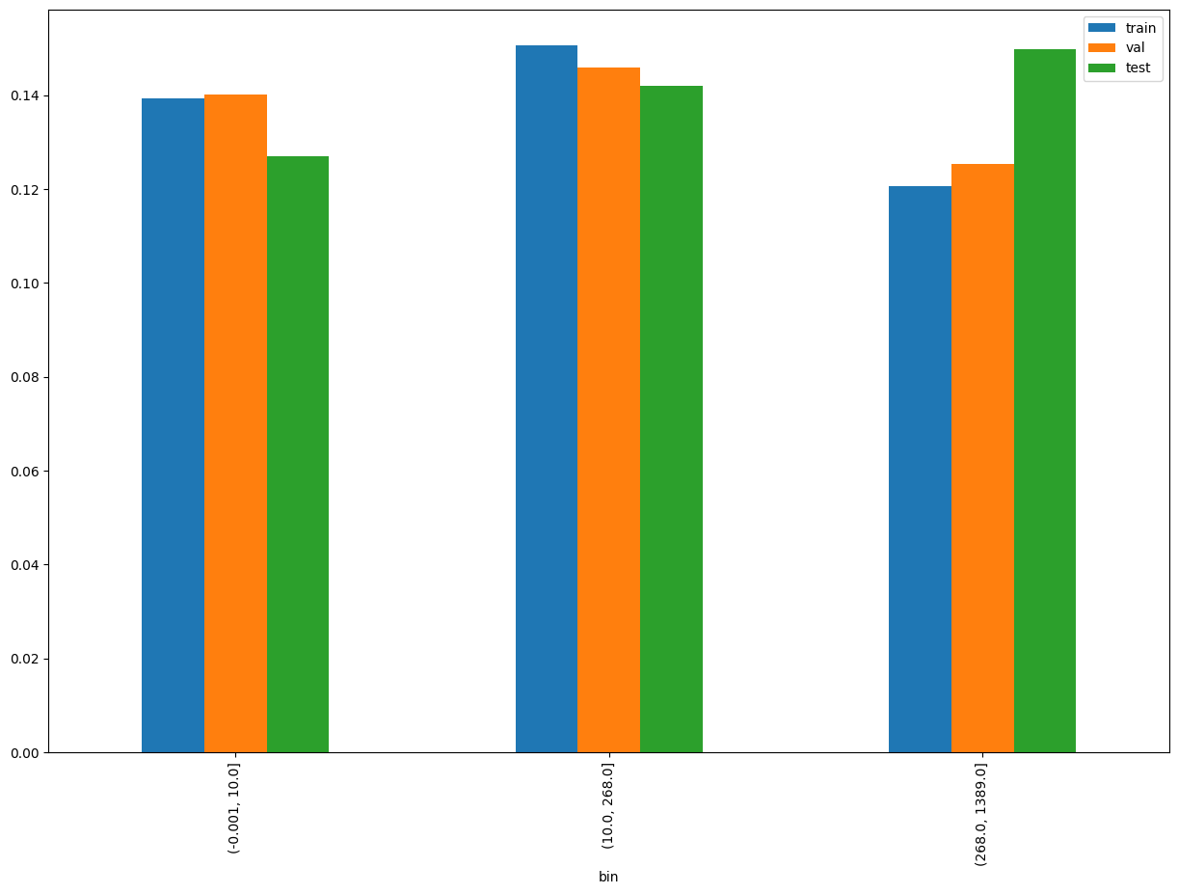
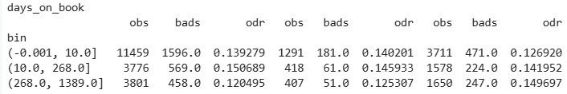
SHAP Rank: 9
days_on_book = (ln_application_submit_time - onboarding_date)

Slide 17
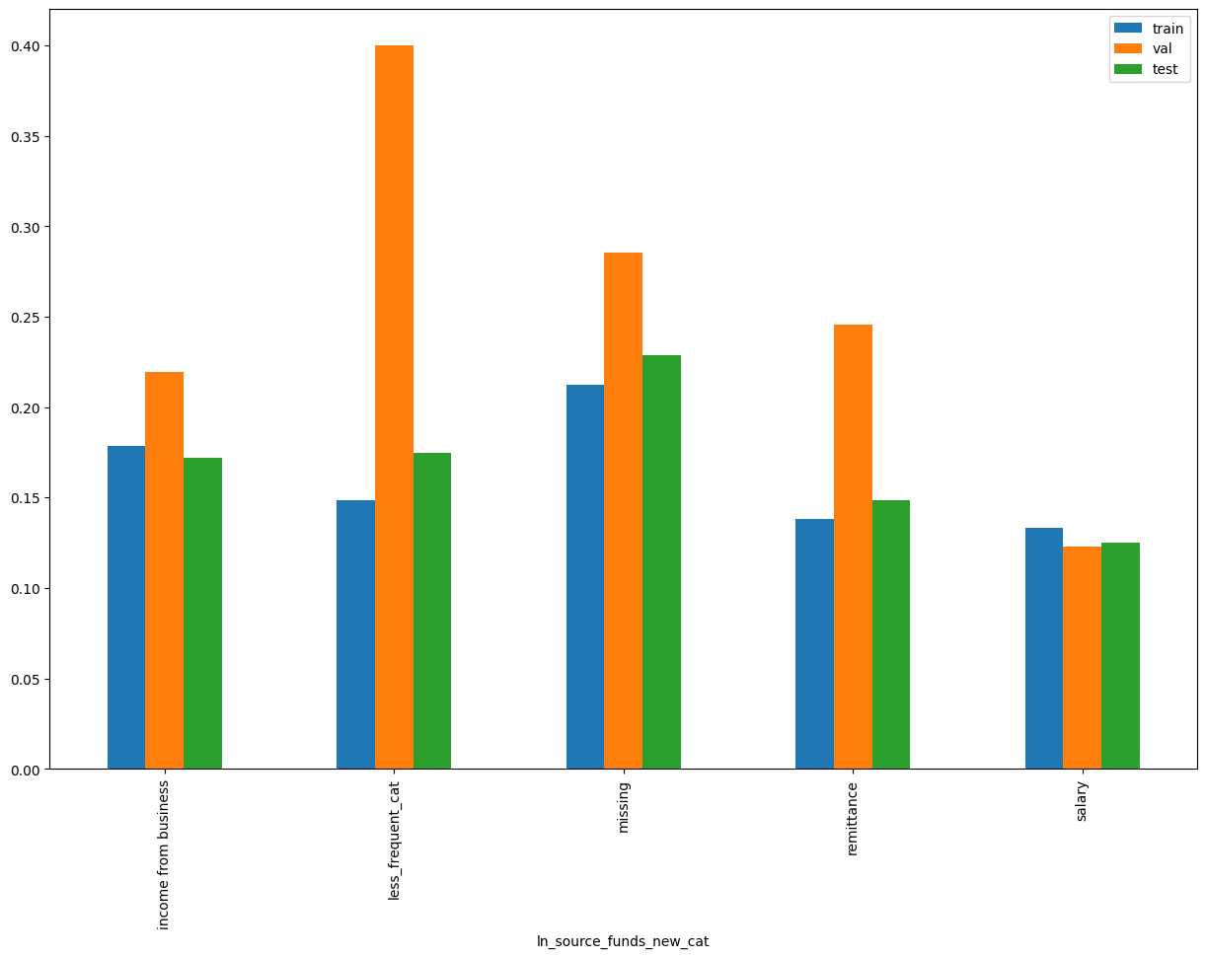

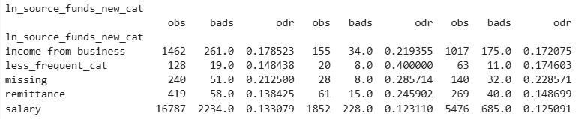
SHAP Rank: 10
ln_source_funds_new_cat ( Used Regex to identify the pattern and rollup the feature)
distribution of less_frequent_cat
Notes:
source_of_fund_reference_map = {
r'(?i)\b(?:monthly\s+(salary|wage|stipend)|salary)\b': 'salary',
r'(?i)(?:(income\s*from\s*business$)|(business(?:.*\s+income)?$))': 'income from business',
r'(?i)\bremitt[ae]nce\b': 'remittance',
# r'(?i)\ballowance\b': 'allowance',
# r'(?i)^inheritance\s*/\s*retirement\s*funds$': 'inheritance/retirement funds',
# r'(?i)^pension$': 'pension',
# r'(?i)^interest\s*on\s*deposits(?:\s*and\s*investments)?$|^investments$': 'interest on deposits and investments'
}
# Initialize a new column with default value
df['ln_source_funds_new_cat'] = 'new'
# Apply mapping using np.where
for pattern, label in source_of_fund_reference_map.items():
df['ln_source_funds_new_cat'] = np.where(df['ln_source_funds_new'].isna(), 'missing',
np.where(df['ln_source_funds_new']=='others', 'missing',
np.where(df['ln_source_funds_new'].isin(['pension','interest on deposits and investments','inheritance/retirement funds','allowance']), 'less_frequent_cat',
np.where(df['ln_source_funds_new'].str.strip().str.lower().str.contains(pattern, regex=True),
label,
df['ln_source_funds_new_cat']
))))

Slide 18
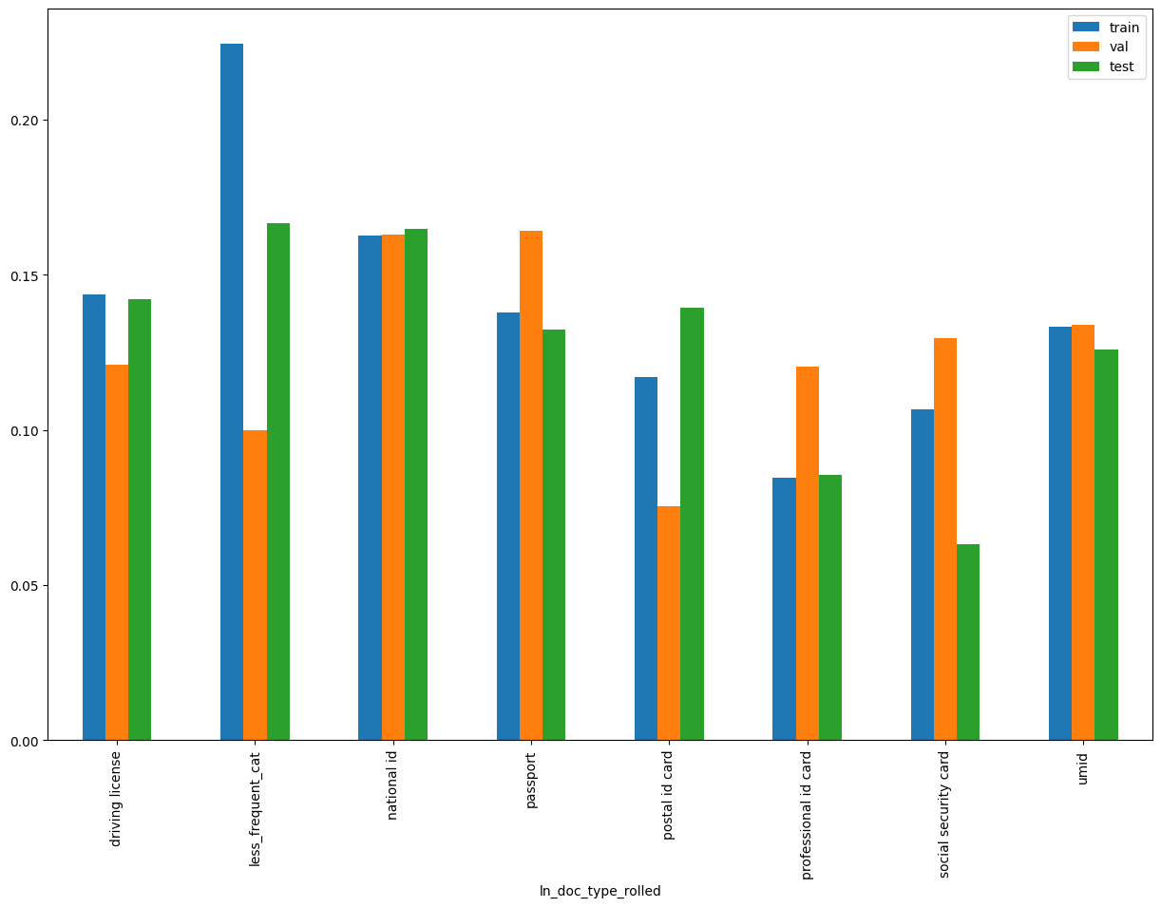

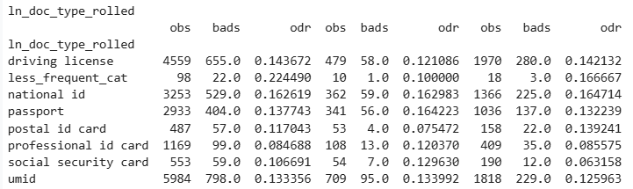
SHAP Rank: 11
ln_doc_type_rolled ( Used Regex to identify the pattern and rollup the feature)
distribution of less_frequent_cat
Notes:
doc_type_reference_map = {
r'(?i)(Driving|Drive|DL)': 'driving license',
r'(?i)(?:)(UMID)': 'umid',
r'(?i)(?:)(ePassport|Passport)': 'passport',
r'(?i)(?:)(Post)': 'postal id card',
r'(?i)(?:)(Social Sec|SSS|security)': 'social security card',
r'(?i)(professional(?:\s*-\s*|\s)id|prc)': 'professional id card',
r'(?i)^(?:philippines\s*[-]?\s*)?(digital(?:\s+or\s+ephilsys)?\s+id|ephilsys|philid|nation|ePhil|national\s+id|id)': 'national id'
}
# Initialize a new column with default value
df['ln_doc_type_rolled'] = 'less_frequent_cat'
# Apply mapping using np.where
for pattern, label in doc_type_reference_map.items():
df['ln_doc_type_rolled'] = np.where(df['ln_doc_type'].isna(), 'missing',
np.where(df['ln_doc_type'].str.strip().str.lower().str.contains(pattern, regex=True),
label,
df['ln_doc_type_rolled']
))

Slide 19
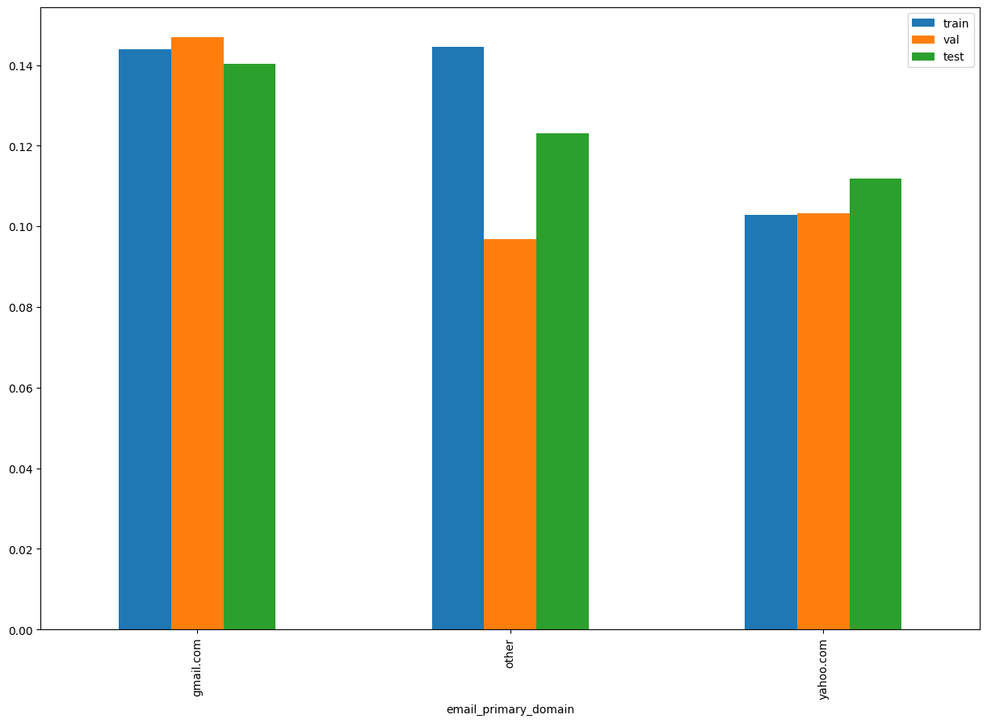
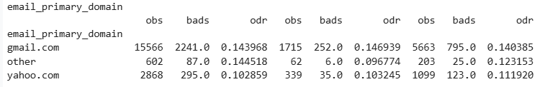
SHAP Rank: 12
email_primary_domain

Slide 20
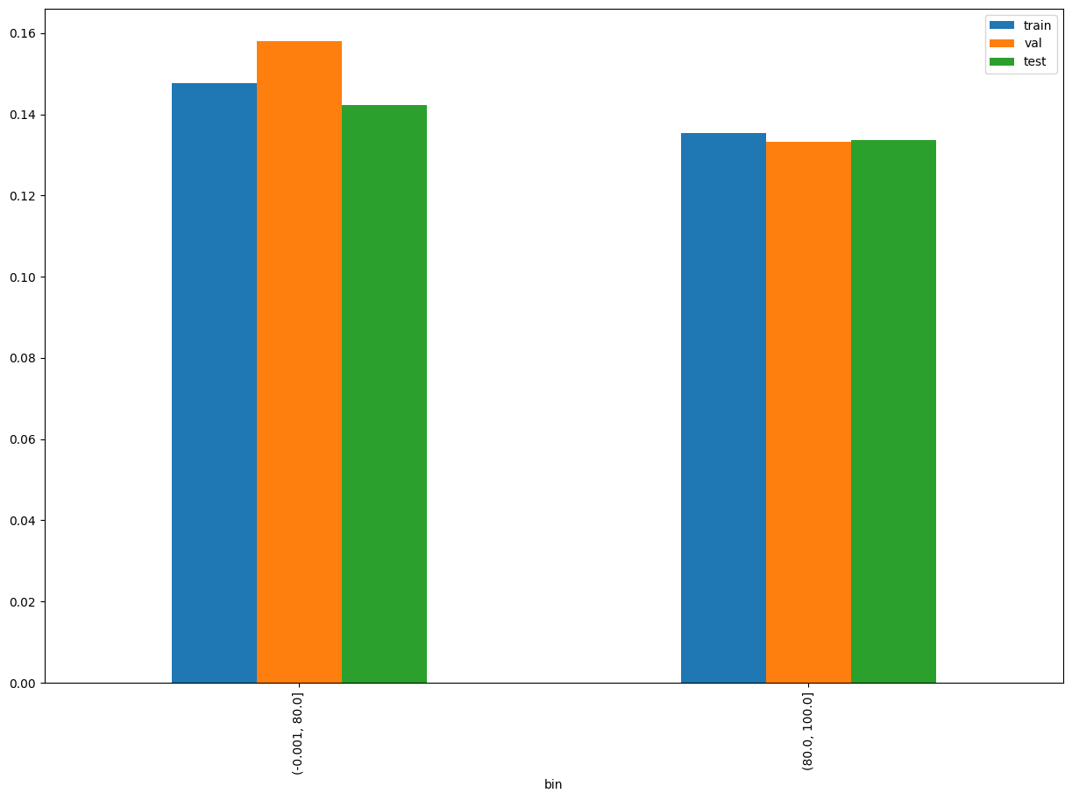
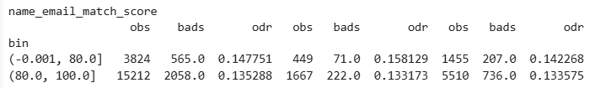
SHAP Rank: 13
name_email_match_score

Slide 21
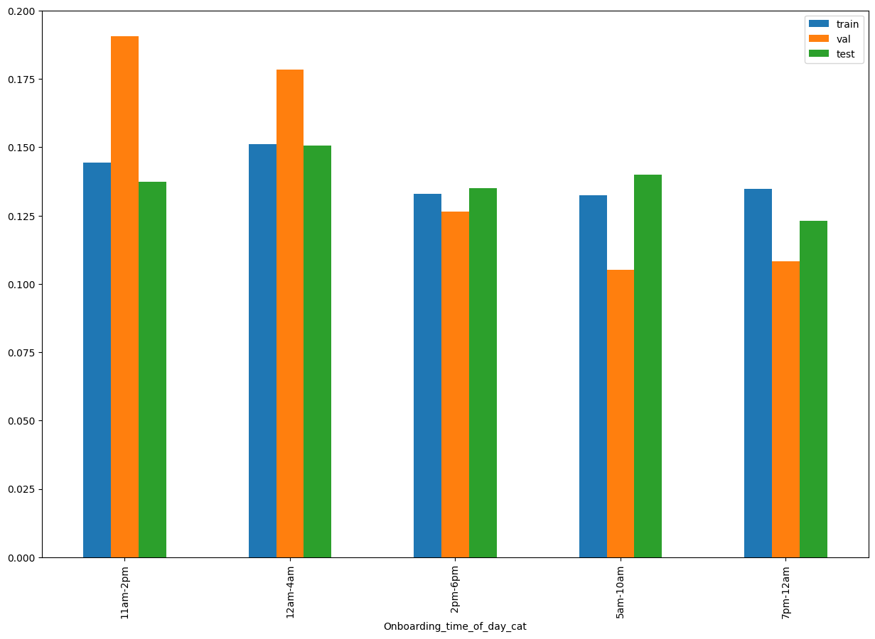
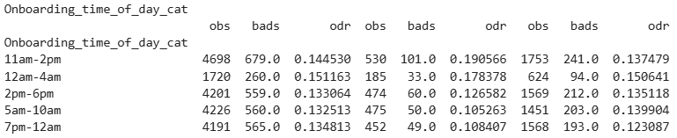
SHAP Rank: 14
Onboarding_time_of_day_cat

Slide 22
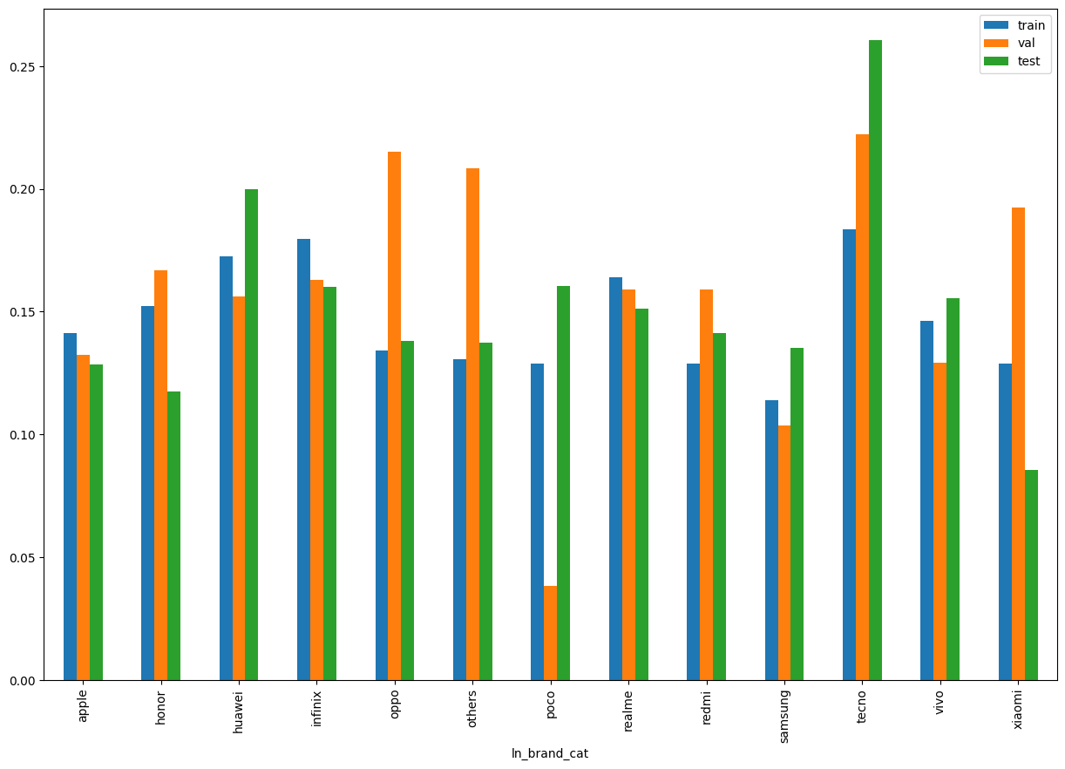
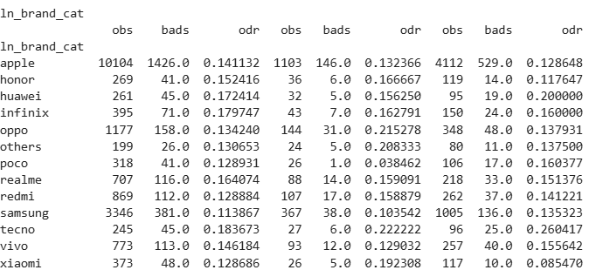
SHAP Rank: 15
ln_brand_cat

Slide 23
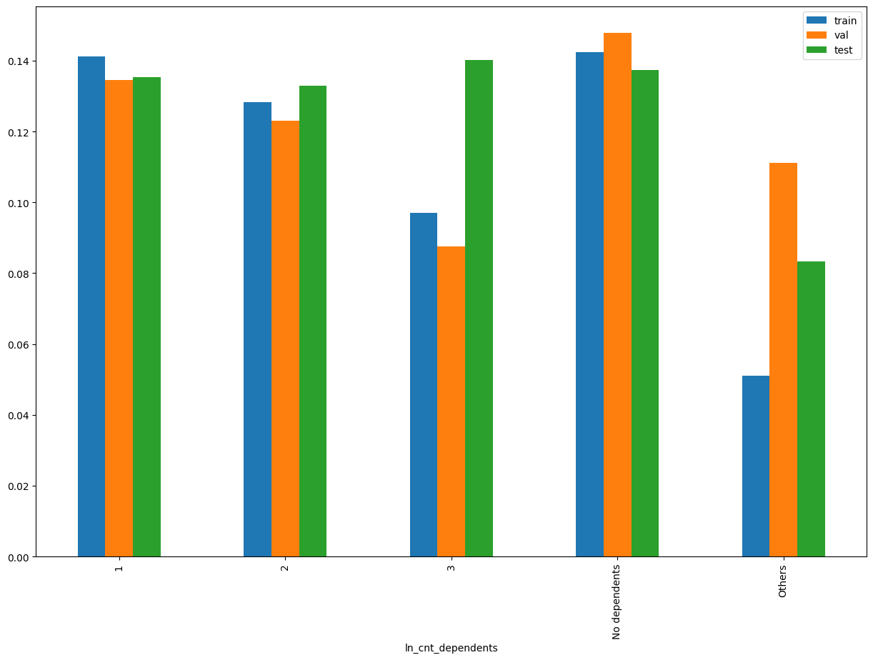
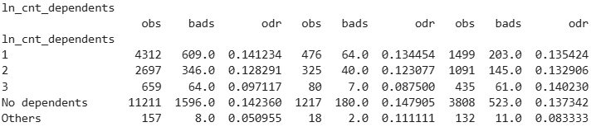
SHAP Rank: 16
ln_cnt_dependents

Slide 24

THANK YOU!
​
Questions?
tonikbank.com

